Slide 1
Types of PCR and its Uses
Molecular pathology series
_{Dr. mukhlld A. ramadhan}

Slide 2
Types of PCR
Conventional PCR
Real time PCR

Slide 3
1. Variants of conventional PCR
Multiplex PCR.
Nested PCR.
Reverse transcription PCR.
Methylation specific PCR.
Hot start PCR.

Slide 4
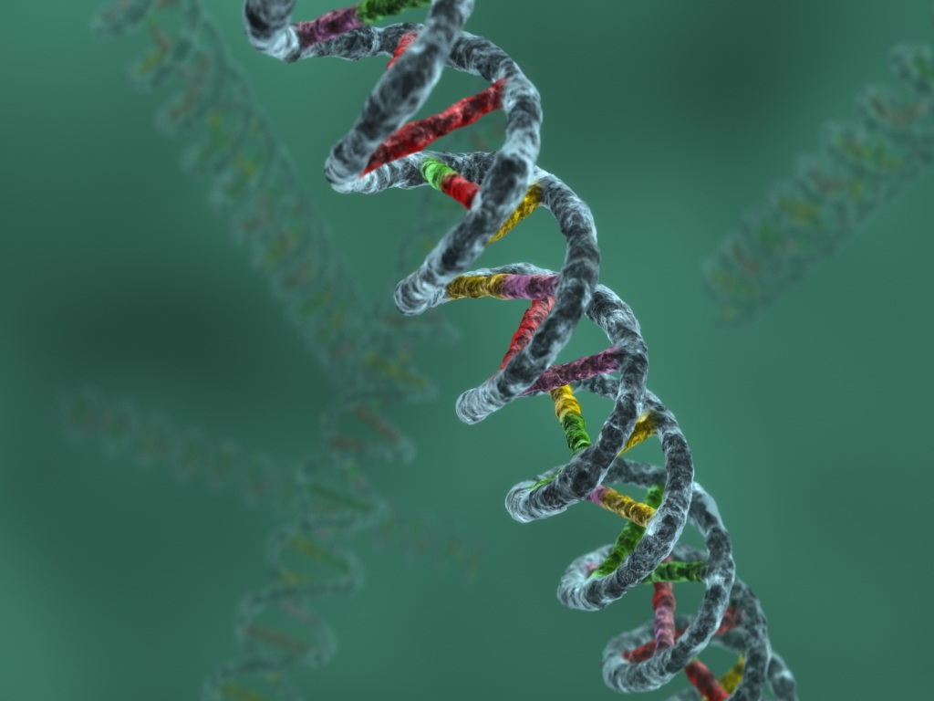
A simple thermocycling protocol
1X
35X
1X
94ºC
94ºC
3 min
1 min
72ºC
72ºC
1 min
5 min
Initial denaturation
of DNA
55ºC
45 sec
denaturation
4ºC
extension
∞ hold
annealing
Final extension

Slide 5
A. Multiplex PCR
Amplifies multiple different regions of DNA at one time.
Multiple primer pairs are used in one reaction.
Uses
Several targets can be analyzed in one specimen.

Slide 6
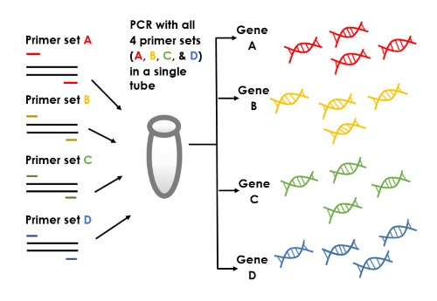

Slide 7
B. Nested PCR
Two pairs of primers are used in this type.
The first primers set (“outer primers”)
second primer set (“inner primers”)
Uses
to improve amplicon yield and specificity.
Detection of pathogens that occur with very few amount.

Slide 9
C. Revers transcription PCR
Revers transcriptase enzyme.
Uses:
Detection of RNA virus like (HCV).
Detection of other M.O. through targeting of
their Ribosomal RNA.

Slide 11
D. Methylation-specific PCR
is used on genomic DNA to determine if the CpG islands within the promoter of a gene are methylated on the cytosine residue (blocking the gene expression in the cell ) or unmethylated (potentially allowing gene expression).
For example, silenced genes on X chromosomes are methylated, as are the promoters of tumor suppressor genes in many cancers.

Slide 12
E. Hot start PCR
This technique preventing Taq from extending
primers until a temperature of 60–80°C is reached.
Uses
Prevents formation of primer dimers
prevents the non-spesific binding of primers to non-target DNA segment.

Slide 13
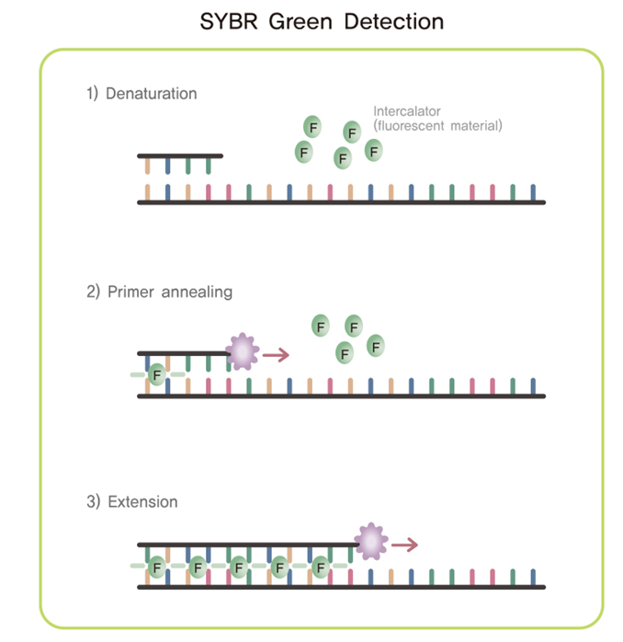
2. Real time PCR

Slide 14
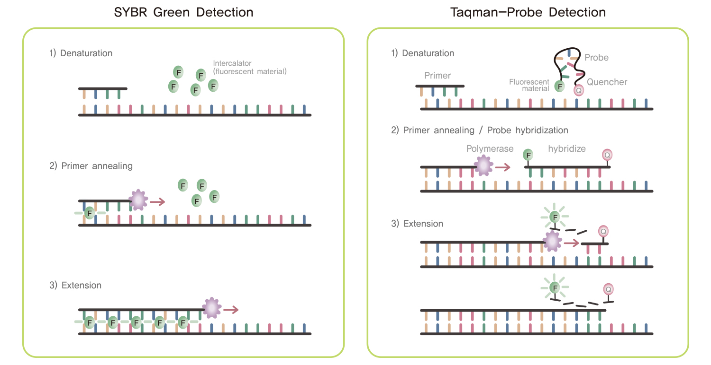
Real time PCR

Slide 15
Thanks
For
Listening

