Slide 1
جامعة ميسان/ كلية الهندسة
قسم الهندسة الكهربائية
يقدم
دورة في حماية نظام القدرة الكهربائية
للفترة من 24- 26/ 8 /2021
تقديم
ا.م.د. احمد ريسان حسين
م.م. هشام داود سلمان
م.م. محمد حسن لازم

Slide 2
Outline
1-Fundamentals of Power System Protection
( Introduction)
2-Why do we need Protection?
3-Types of Protection
4-What is a Relay?
5-Evolution of Relays
6-Directional Overcurrent Protection
7-Distance Protection
8-Differential Protection

Slide 3
Fundamentals of Power System Protection
Introduction
Electrical energy systems consists of various equipment's connected together. Typically, power is generated at lower voltages (a few kV) (3-phase ac voltage source) which is stepped up by a transformer and fed into a transmission grid. Thermal power should be generated at pit heads and hydro power at reservoirs. This system has to be protected from abnormalities which is the task of protection system.

Slide 4
Analogy with Functioning of a Human being
A human being is a complex system that performs through various apparatus like legs, hands, eyes, ears, heart, bones, blood vessels etc. The heart is analogous to an electrical generator and stomach to the boiler. The eating process provides raw material to generate calories. The power generated is pumped by heart through a complex network of blood vessels. The primary transmission is through arteries and veins. Furthermore, distribution is through fine capillaries. The system operator is the brain which works on inputs of eyes, ears, skin etc. Diagnosing abnormality in any of these organs and taking remedial measures can be thought of as job of "apparatus protection". However, does this cover the complete gambit of anomalies? Are fever, infection etc, a specific apparatus problem? Why does it cause overall deterioration in functioning of the human being?
The answer lies in the fact that the system which encompasses body has also abstraction like the mind. Overall health is not just an aggregation of apparatus. It is something much more complex. It involves complex process and associated dynamics (biological, chemical, mechanical etc.)

Slide 5
Why do we need Protection?
Electrical power system operates at various voltage levels from 415 V to 400 kV or even more. Electrical Apparatus used may be enclosed (e.g., motors) or placed in open (e.g., transmission lines). All such equipment undergo abnormalities in their life time due to various reasons. For example, a worn out bearing may cause overloading of a motor. A tree falling or touching an overhead line may cause a fault.

Slide 6
Types of Protection
Apparatus Protection
System Protection

Slide 7
Apparatus Protection
Transmission Line Protection and feeder protection
Motor Protection
Transformer Protection
Generator Protection
Busbar Protection

Slide 8
What is a Relay?
Formally, a relay is a logical element which processes the inputs (mostly voltages and currents) from the. System/apparatus and issues a trip decision if a fault within the relay's jurisdiction is detected.

Slide 9
The relay element analyzes these inputs and decides whether (a) there is a abnormality or a fault and (b) if yes, whether it is within jurisdiction of the relay. The jurisdiction of relay R1 is restricted to bus B where the transmission line terminates. If the fault is in it's jurisdiction, relay sends a tripping signal to circuit breaker(CB) which opens the circuit. A real life analogy of the jurisdiction of the relay can be thought by considering transmission lines as highways on which traffic (current/power) flows.

Slide 10
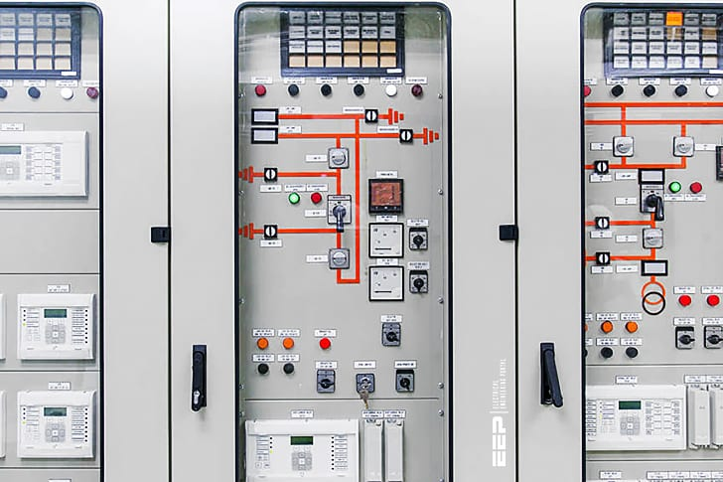
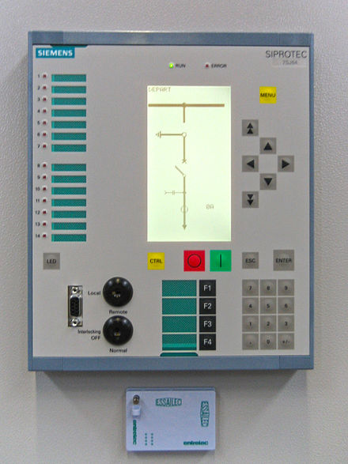

Slide 11
Evolution of Relays
Electromechanical Relays
Solid State Relays
Numerical Relays

Slide 12
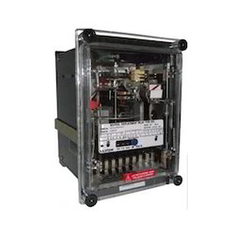
Electromechanical Relays
When the principle of electromechanical energy conversion is used for decision making, the relay is referred as an electromechanical relay. These relays represent the first generation of relays. Let us consider a simple example of an over current relay, which issues a trip signal if current in the apparatus is above a reference value

Slide 13
Solid State Relays
With the advent of transistors, operational amplifiers etc., solid state relays were developed. They realize the functionality through various operations like comparators etc. They provide more flexibility and have less power consumption than their electromechanical counterpart. A major advantage with the solid state relays is their ability to provide self-checking facility i.e. the relays can monitor their own health and raise a flag or alarm if its own component fails. Some of the advantages of solid state relays are low burden, improved dynamic performance characteristics, high seismic withstand capacity and reduced panel space.

Slide 14
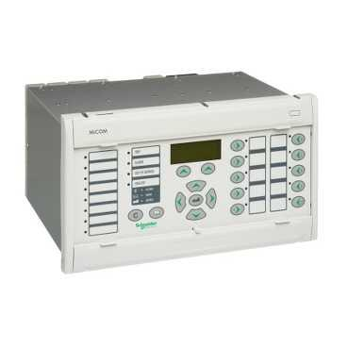
Numerical Relays
The block diagram of a numerical relay is shown in fig 1.5. It involves analog to digital (A/D) conversion of analog voltage and currents obtained from secondary of CTs and VTs. These current and voltage samples are fed to the microprocessor or Digital Signal Processors (DSPs) where the protection algorithms or programs process the signals and decide whether a fault exists in the apparatus under consideration or not. In case, a fault is diagnosed, a trip decision is issued. Numerical relays provide maximum flexibility in defining relaying logic.

Slide 15
What is a Circuit Breaker?
A Circuit Breaker (CB) is basically a switch used to interrupt the flow of current. It opens on relay command. The relay command initiates mechanical separation of the contacts. It is a complex element because it has to handle large voltages (few to hundreds of kV's) and currents (in kA's). Interrupting capacity of the circuit breaker is therefore expressed in MVA. Power systems under fault behave more like inductive circuits. X/R ratio of lines is usually much greater than unity.
Usually CB opening time lies in the 2-6 cycles range. CBs are categorized by the interrupting medium used. Minimum oil, air blast, vacuum arc and SF6 CBs are some of the common examples. CB opening mechanism requires much larger power input than what logical element relay can provide.

Slide 16
Protection Paradigms - Apparatus Protection
a radial distribution system with a single source. The fault current is fed from only one end of the feeder. For this system it can be observed that:
To relay R₁, both downstream faults F₁ and F₂ are visible i.e. I_{F1} as well as I_{F2} pass through CT of R₁.
To relay R₂, fault F₁, an upstream fault is not seen, only F₂ is seen. This is because no component of I_{F1} passes through CT of R₂.
Thus, selectivity is achieved naturally. Relaying decision is based solely on the magnitude of fault current. Such a protection scheme is said to be non-directional.

Slide 17
Directional Overcurrent Protection
In contrast, there can be situations where for the purpose of selectivity; phase angle information (always relative to a reference phasor) may be required. Consequently, fault is fed from both the ends of the feeder. To interrupt the fault current, relays at both ends of the feeder are required. In this case, from the magnitude of the current seen by the relay R₂, it is not possible to distinguish whether the fault is in the section AB or BC. Since faults in section AB are not in its jurisdiction, it should not trip. To obtain selectivity, a directional overcurrent relay is required. It uses both magnitude of current and phase angle information for decision making. It is commonly used in sub transmission networks where ring mains are used.

Slide 18
Distance Protection
Consider a simple radial system, which is fed from a single source. Let us measure the apparent impedance (V/I) at the sending end. For the unloaded system, I = 0, and the apparent impedance seen by the relay is infinite. As the system is loaded, the apparent impedance reduces to some finite value (Z_{L}+Z_{Line}) where Z_{L} is the load impedance and Z_{Line} is the line impedance. In presence of a fault at a per-unit distance ‘m', the impedance seen by the relay drops to a m Z_{Line} as shown in fig 2.3.

Slide 19
Differential Protection
Principle of Differential Protection
Differential protection is based on the fact that any fault within an electrical equipment would cause the current entering it, to be different, from the current leaving it. Thus by comparing the two currents either in magnitude or in phase or both we can determine a fault and issue a trip decision if the difference exceeds a predetermined set value.

Slide 20
Differential Protection for Transmission Line
Fig 2.6 shows a short transmission line in which shunt charging can be neglected. Then under no fault condition, phasor sum of currents entering the device is zero i.e.$Ī_{s}+Ī_{R}=0$. Thus, we can say that differential current under no fault condition is zero. However in case of fault in the line segment AB, we get $Ī_{s}+Ī_{R}=Ī_{F} ≠0$, i.e. differential current in presence of fault is nonzero.

Slide 21
Differential Protection for Transmission Line (Tapped Line)
Differential protection can be used for tapped lines (multiterminal lines) where boundary conditions are defined as follows:
Under no fault condition: $Ī_{1}+Ī_{2}+Ī_{3}=0$ and Faulted condition $Ī_{1}+Ī_{2}+Ī_{3} ≠0$.
Differential protection for detecting faults is an attractive option when both ends of the apparatus are physically located near each other. e.g. on a transformer, a generator or a bus bar.

Slide 22
Differential Protection for Transformer
Consider an ideal transformer with the CT connections, as shown in fig 2.8. To illustrate the principle let us consider that current rating of primary winding is 100A and secondary winding is 1000A. Then if we use 100:5 and 1000:5 CT on the primary and secondary winding, then under normal (no fault) operating conditions the scaled CT currents will match in magnitudes. By connections the primary and secondary CTs with due care to the dots (polarity markings), a circulating current can be set up as shown by dotted line.

Slide 23
No current will flow through the branch having overcurrent current relay because it will result in violation of KCL. Now if an internal fault occurs within the device like interturn short etc., then the normal mmf balance is upset i.e.$N_{1}I_{1}≠N_{2}I_{2}$ . Under this condition, the CT secondary currents of primary and secondary side CTs will not match

Slide 24
Differential Protection for Busbar
Ideally, differential protection is the solution for the bus-bar protection
Figure 2.8 illustrates the basic idea. If the fault is external to the bus, it can be seen that algebraic sum of the currents entering the bus is zero.
On the other hand, if fault is on the bus (internal fault), this sum is not zero.
Thus, differential protection can be used to protect a bus.

Slide 25
Thank you
For listening

